Slide 1

Project Report
Reinforcement Learning Modeling of the Iowa Gambling Task
202011003 강승수
202211080 박시윤
202311132 이상아

Slide 2
INDEX
1. Project overview
2. Activities performed by week/ team member
Project Report
Reinforcement Learning Modeling of
the Iowa Gambling Task
3. Methodology
4. Execution result and analysis
5. Conclusion
6. References and Resources

Slide 3
1. Project overview
Project overview
Week 1
Iowa Gambling Task
Environment Setup
Using Q-learning and Valence-specific
Q-learning
Parameter estimation for each participant
using maximum likelihood estimation
Add Learners Classification
Run the RL model using median estimated parameters
to simulate average human behavior
Estimate parameters from each member’s IGT data
and interpret them
in relation to
personality traits
Add Clustering Procedure

Slide 4
1. Project overview
Project overview
Week 2
Iowa Gambling Task
Environment Setup
Using Q-learning and Valence-specific
Q-learning
Parameter estimation for each participant
using maximum likelihood estimation
Add Learners Classification
Run the RL model using median estimated parameters
to simulate average human behavior
Estimate parameters from each member’s IGT data
and interpret them
in relation to
personality traits
Add Clustering Procedure

Slide 5
1. Project overview
Project overview
Iowa Gambling Task
Environment Setup
Using Q-learning and Valence-specific
Q-learning
Parameter estimation for each participant
using maximum likelihood estimation
Add Learners Classification
Week 3
Run the RL model using median estimated parameters
to simulate average human behavior
Estimate parameters from each member’s IGT data
and interpret them
in relation to
personality traits
Add Clustering Procedure

Slide 6
2. Activities performed by week/ team member
VS Q learning model
Complete fully MLE code
See the distribution of estimated parameters
Week 2
Week 1
Week 3
Cluster learner dataset
Find the mean parameters of each clusters
- Estimate parameters of each members and simulate on IGT environment
IGT environment
Q learning model
Early MLE code

Slide 7
2. Activities performed by week/ team member
강승수
VS Q learning model
Complete fully MLE code
See the distribution of estimated parameters
Week 2
Week 1
Week 3
Cluster learner dataset
Find the mean parameters of each clusters
- Estimate parameters of each members and simulate on IGT environment
IGT environment
Q learning model
Early MLE code

Slide 8
2. Activities performed by week/ team member
VS Q learning model
Complete fully MLE code
See the distribution of estimated parameters
+ Classification
+ IGT Game Playing Code
박시윤
Week 2
Week 1
Week 3
Cluster learner dataset
Find the mean parameters of each clusters
- Estimate parameters of each members and simulate on IGT environment
IGT environment
Q learning model
Early MLE code

Slide 9
2. Activities performed by week/ team member
VS Q learning model
Complete fully MLE code
See the distribution of estimated parameters
+ Preprocessing
+ Reference tracking
+ Code organization
이상아
Week 2
Week 1
Week 3
Cluster learner dataset
Find the mean parameters of each clusters
- Estimate parameters of each members and simulate on IGT environment
IGT environment
Q learning model
Early MLE code

Slide 10
2. Activities performed by week/ team member
VS Q learning model
Complete fully MLE code
See the distribution of estimated parameters
Week 2
Week 1
Week 3
Cluster learner dataset
Find the mean parameters of each clusters
- Estimate parameters of each members and simulate on IGT environment
IGT environment
Q learning model
Early MLE code

Slide 11
2. Activities performed by week/ team member
VS Q learning model
Complete fully MLE code
See the distribution of estimated parameters
Week 2
Week 1
Week 3
Cluster learner dataset
Find the mean parameters of each clusters
- Estimate parameters of each members and simulate on IGT environment
IGT environment
Q learning model
Early MLE code

Slide 12
2. Activities performed by week/ team member
VS Q learning model
Complete fully MLE code
See the distribution of estimated parameters
Week 2
Week 1
Week 3
Cluster learner dataset
Find the mean parameters of each clusters
- Estimate parameters of each members and simulate on IGT environment
IGT environment
Q learning model
Early MLE code

Slide 13
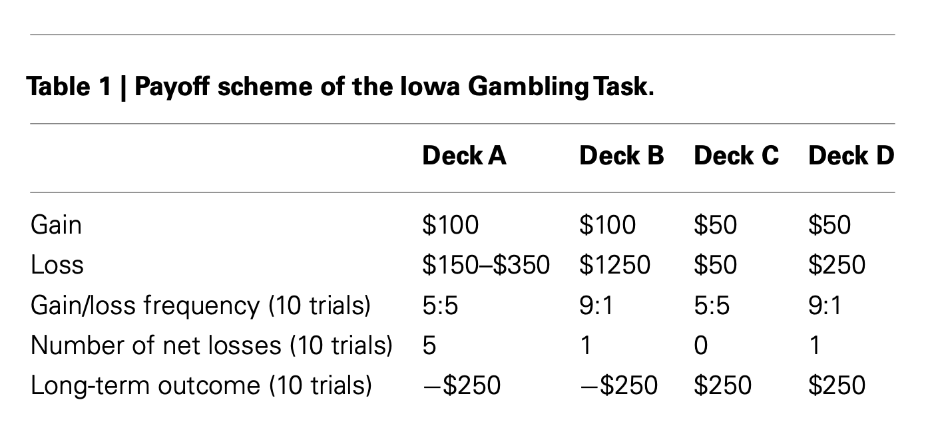
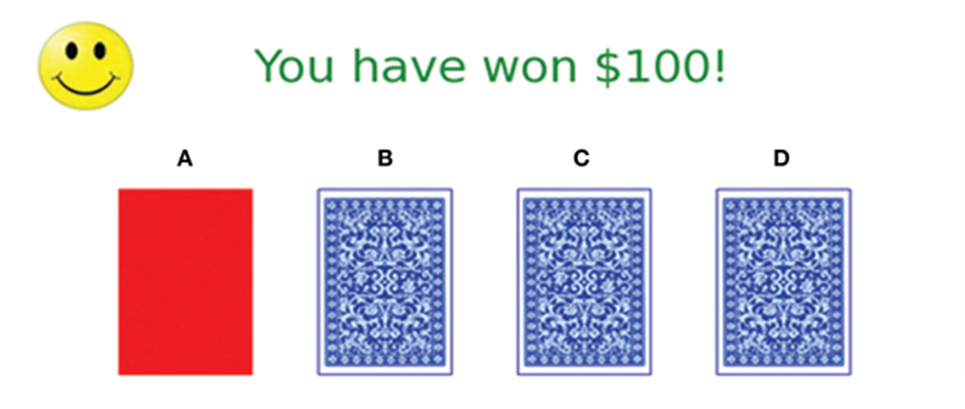
3. Methodology
IGT environment
Horstmann et al. (2012)

Slide 14
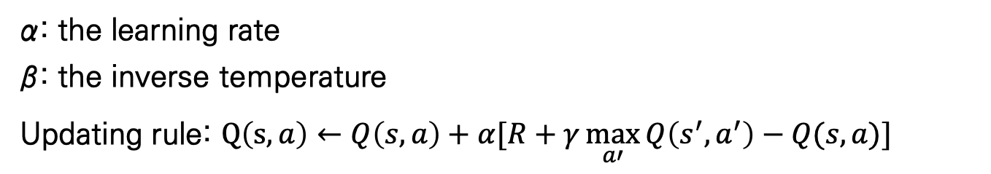
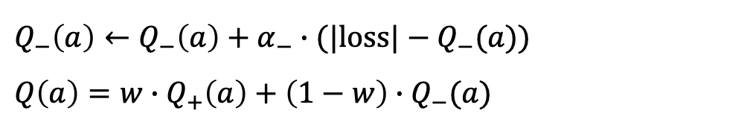
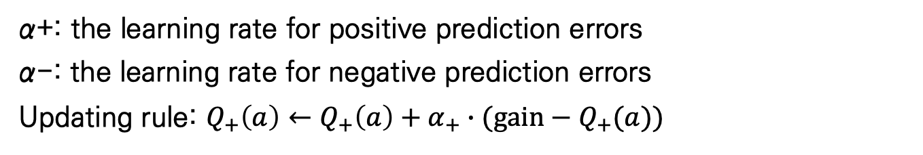
3. Methodology
Models used
Q-learning
α: the learning rate
β: the inverse temperature
Updating rule: $Q\left(s, a\right)←Q\left(s, a\right)+α[R+γ\max_{a′}{Q\left(s^{′},a^{′}\right)−Q(s,a)}]$
Valance specific Q-learning
α+: the learning rate for positive prediction errors
α-: the learning rate for negative prediction errors
Updating rule: $Q_{+}\left(a\right)←Q_{+}\left(a\right)+α_{+}∙(gain−Q_{+}(a))$
$$Q_{−}\left(a\right)←Q_{−}\left(a\right)+α_{−}∙(|loss|−Q_{−}(a))$$
$$Q\left(a\right)=w∙Q_{+}\left(a\right)+\left(1−w\right)∙Q_{−}(a)$$

Slide 15
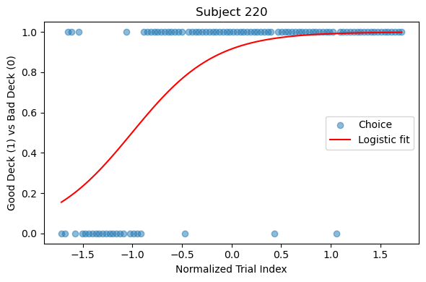
3. Methodology
Classification of participants who successfully learned the IGT
198 participants were identified as successful learners out of 602 participants

Slide 16
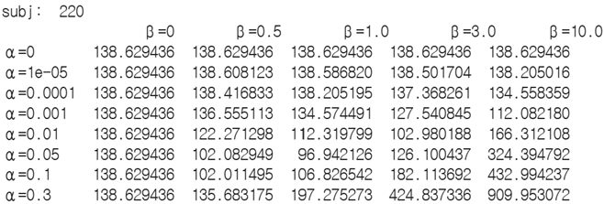
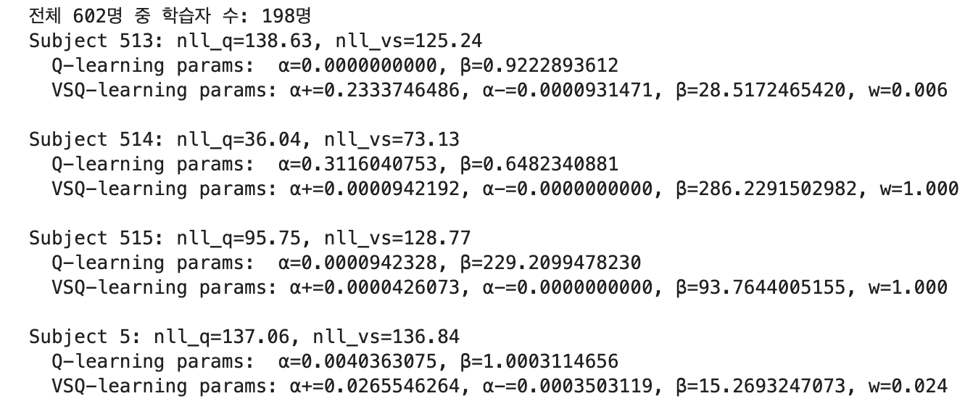
3. Methodology
Parameter estimation and Clustering
Grid Search
Estimate Value based on MLE

Slide 17
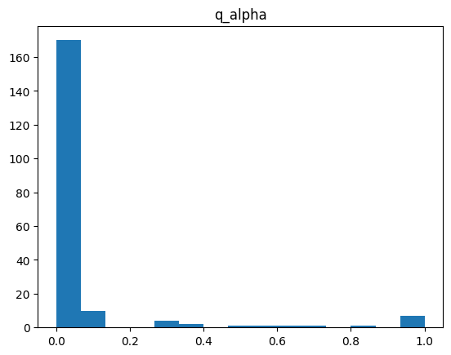
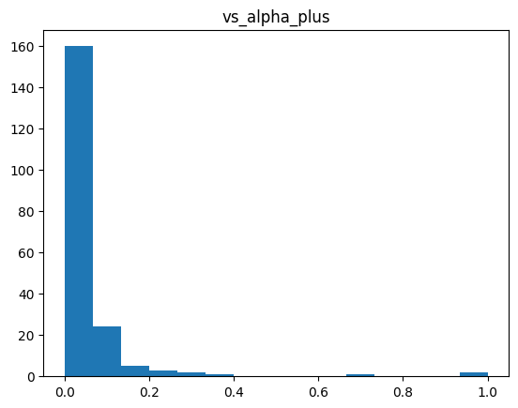
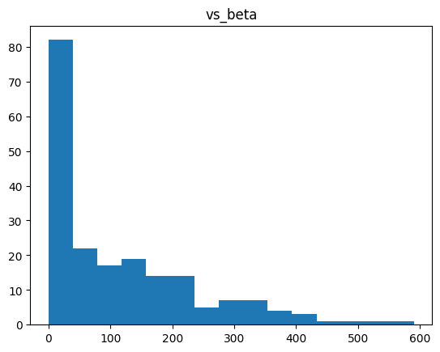
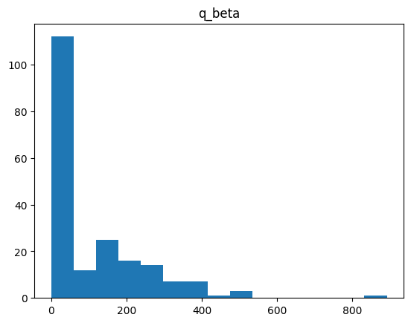
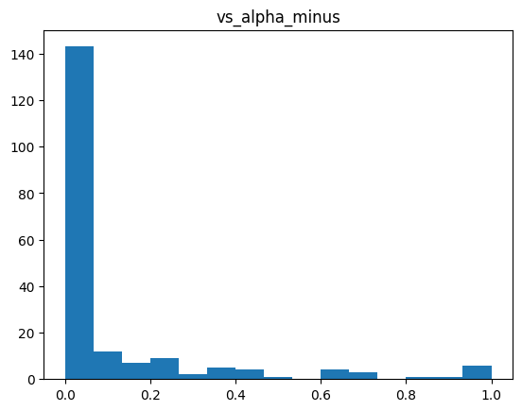
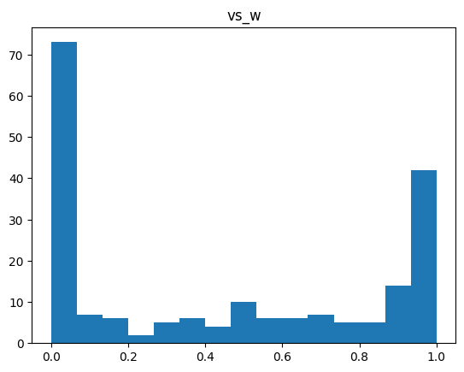
3. Methodology
Parameter estimation and Clustering
Check the parameter distribution

Slide 18
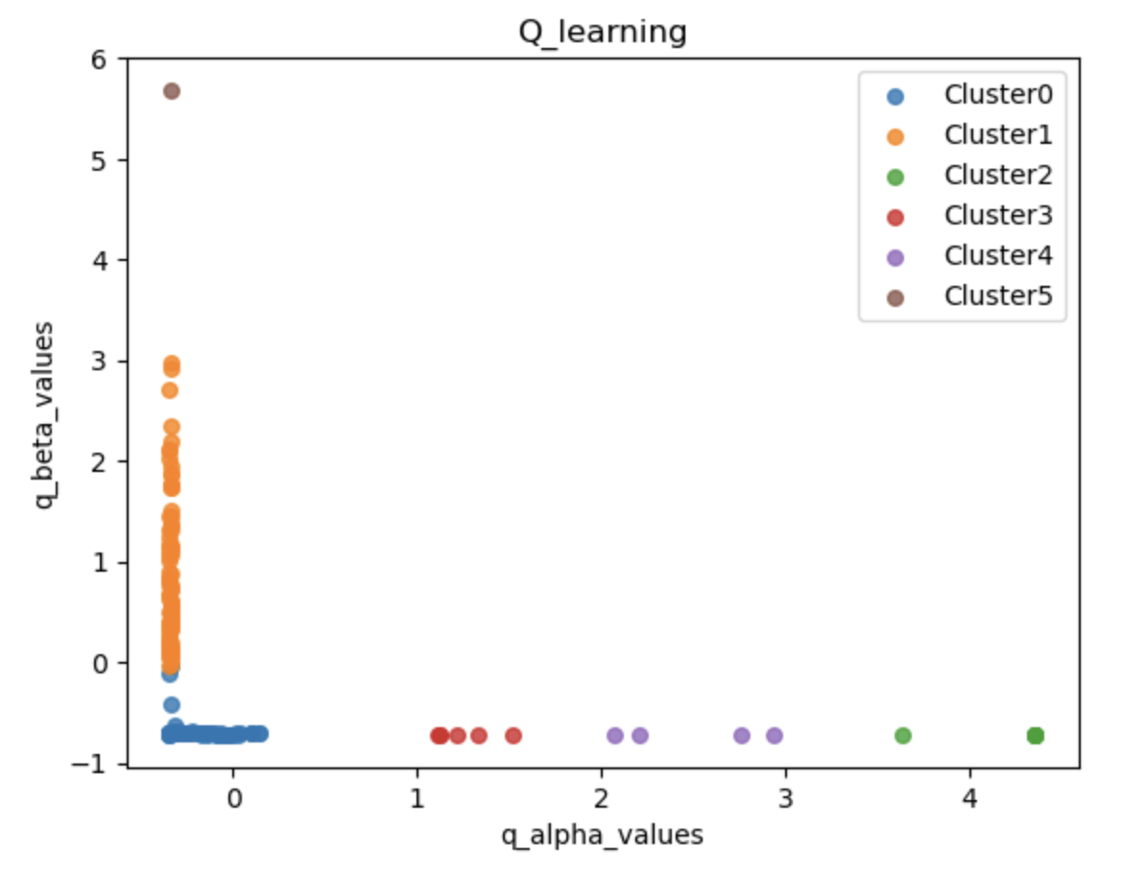
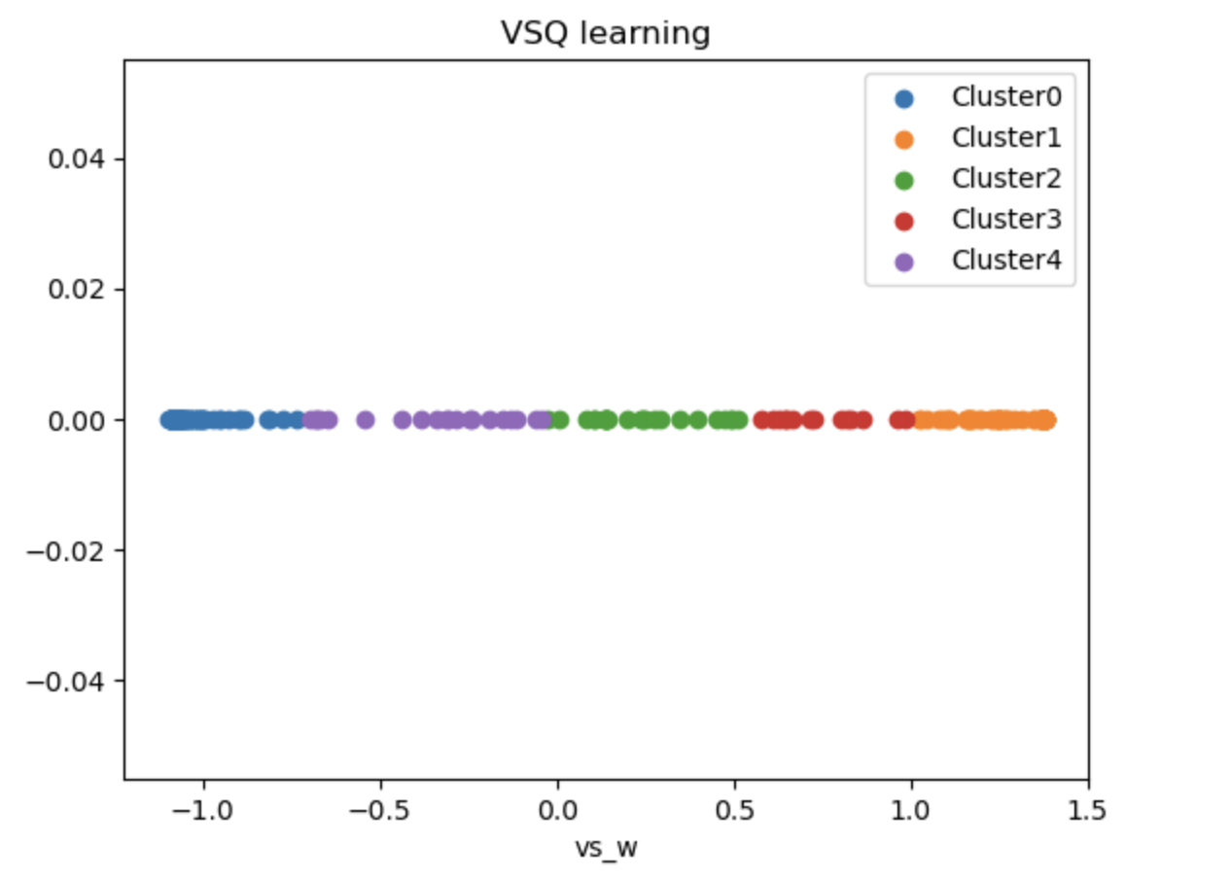
3. Methodology
Parameter estimation and Clustering
Subject Clustering

Slide 19
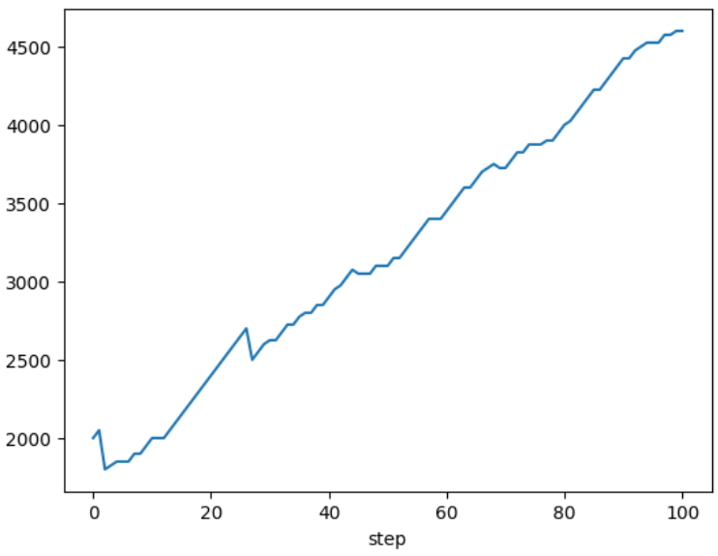
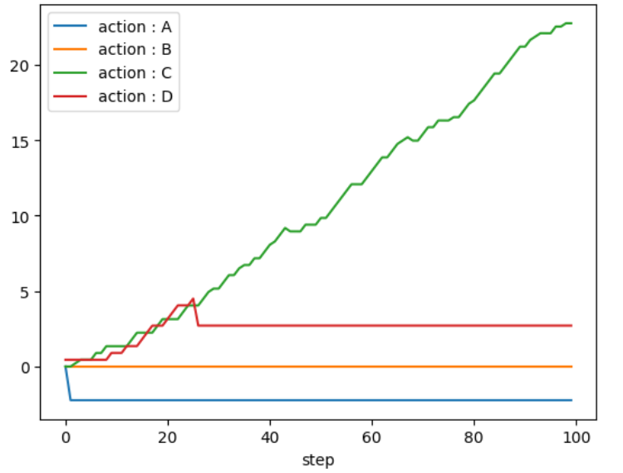
4. Execution result and Analysis
Estimated parameter applied Simulation
Q-learning for cluster 0 (high 𝜶, low 𝜷)
Cumulative Rewards
Q value for action

Slide 20
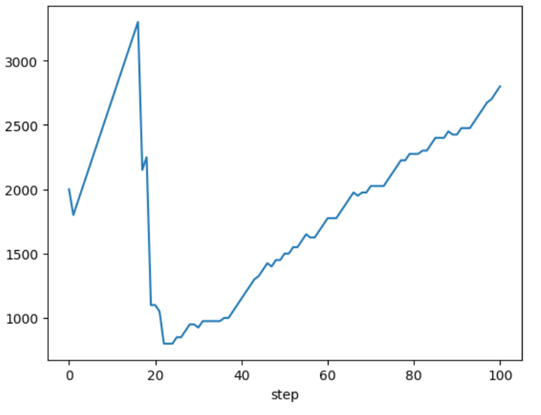
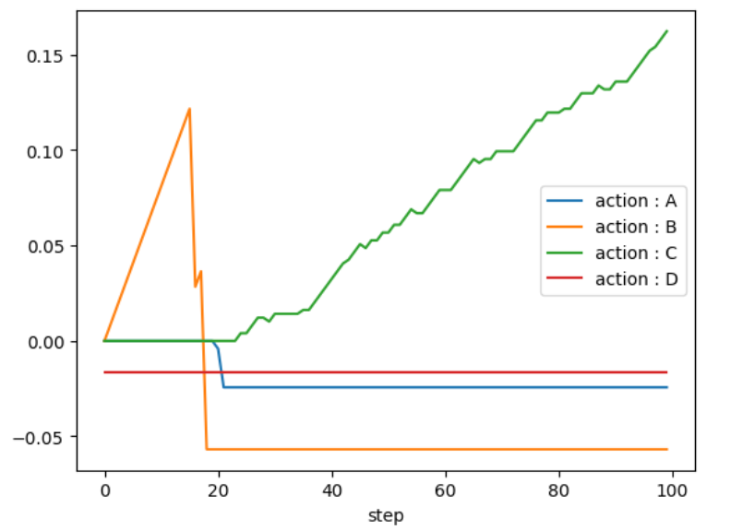
4. Execution result and Analysis
Estimated parameter applied Simulation
Q-learning for cluster 1 (low 𝜶, high 𝜷)
Cumulative Rewards
Q value for action

Slide 21
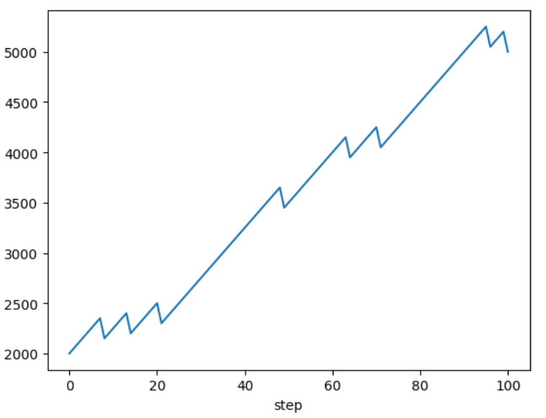
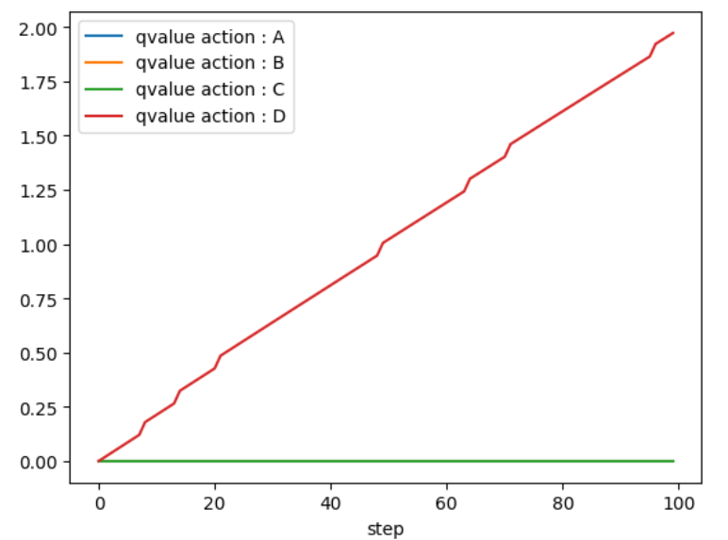
4. Execution result and Analysis
Estimated parameter applied Simulation
Valance specific Q-learning for cluster 0 (low w)
Cumulative Rewards
Q value for action

Slide 22
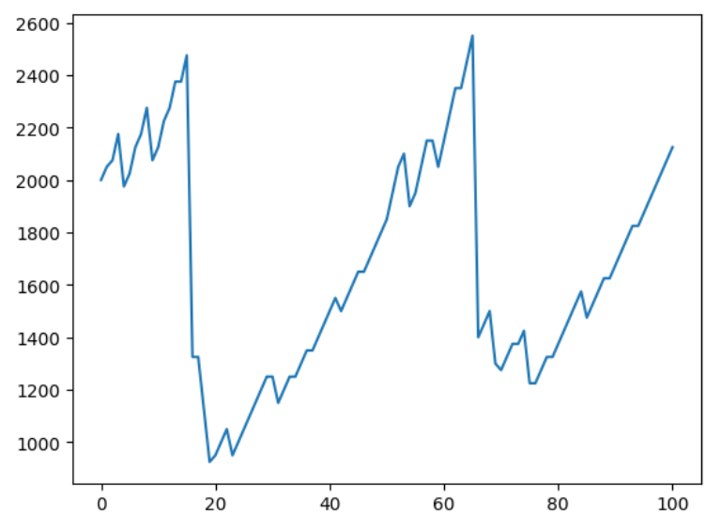
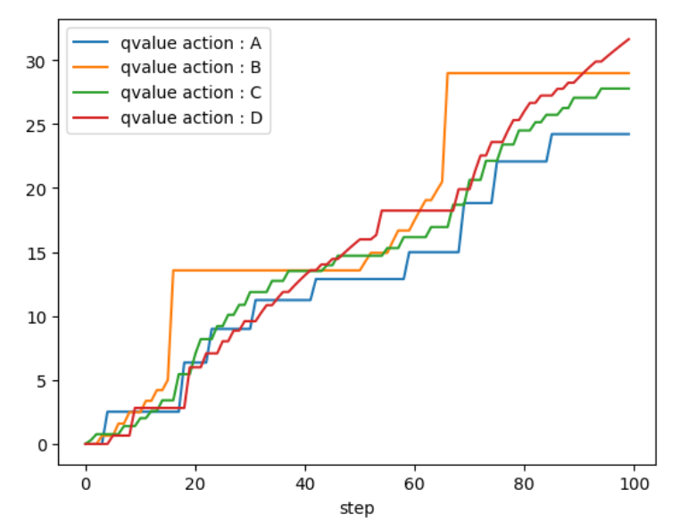
4. Execution result and Analysis
Estimated parameter applied Simulation
Valance specific Q-learning for cluster 1 (high w)
Cumulative Rewards
Q value for action

Slide 23
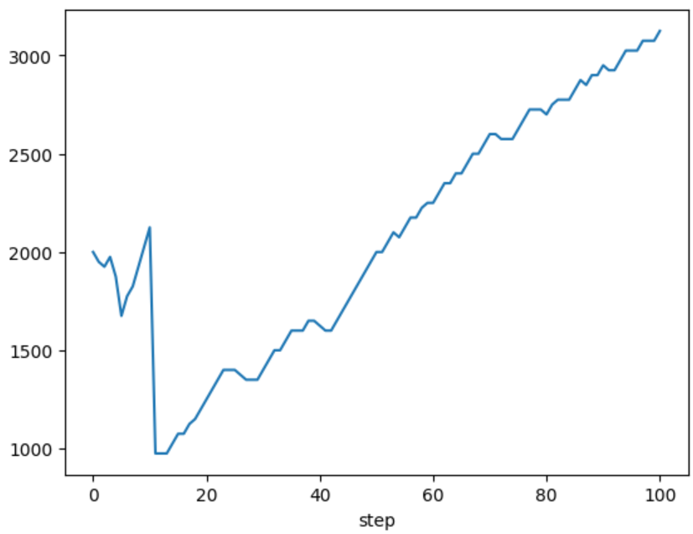
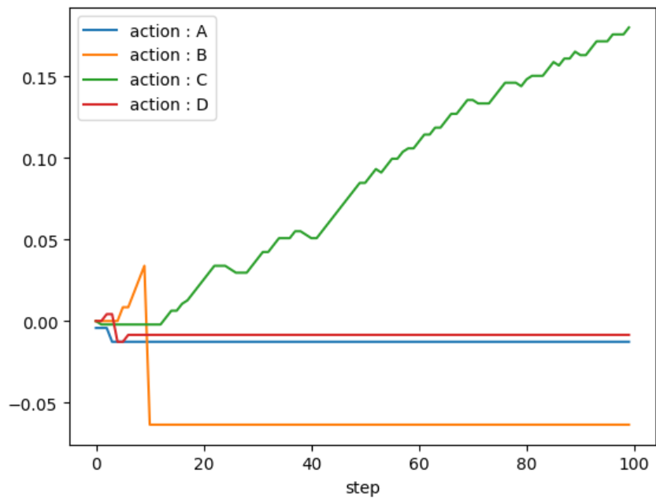
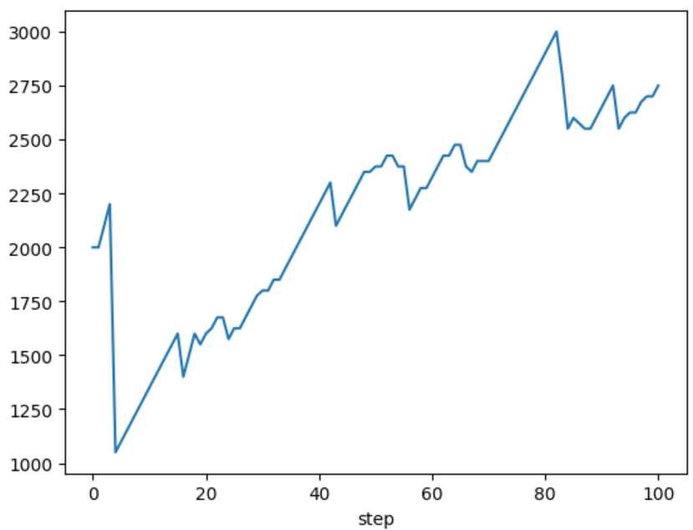
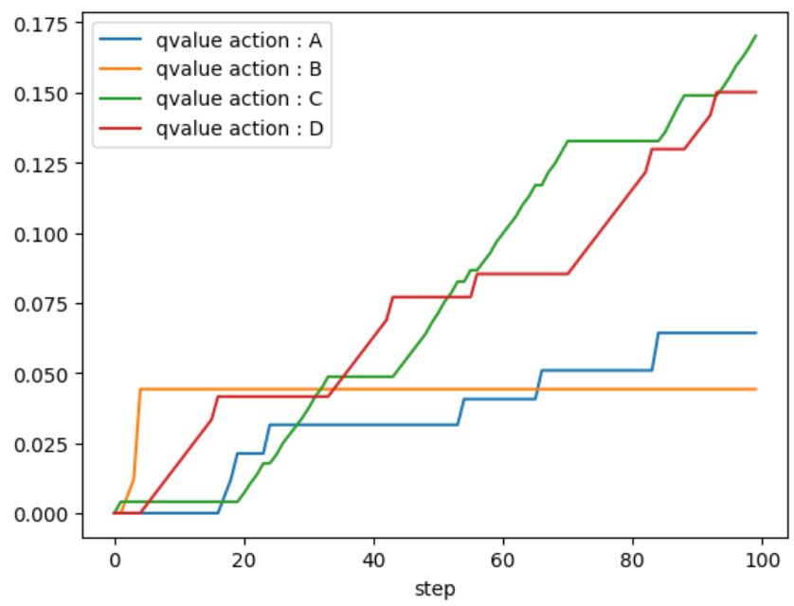
4. Execution result and Analysis
Estimated parameter of team members applied Simulation
Cumulative Rewards
Q value for action
강승수
Q-learning
VS Q-learning

Slide 24
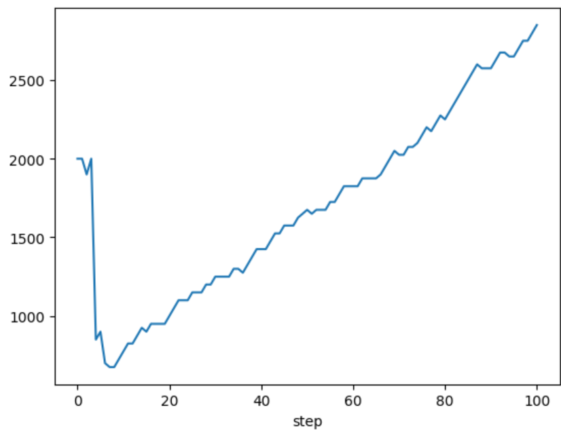
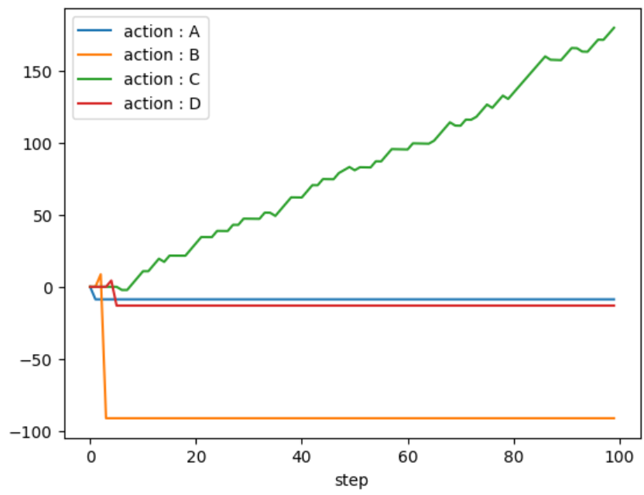
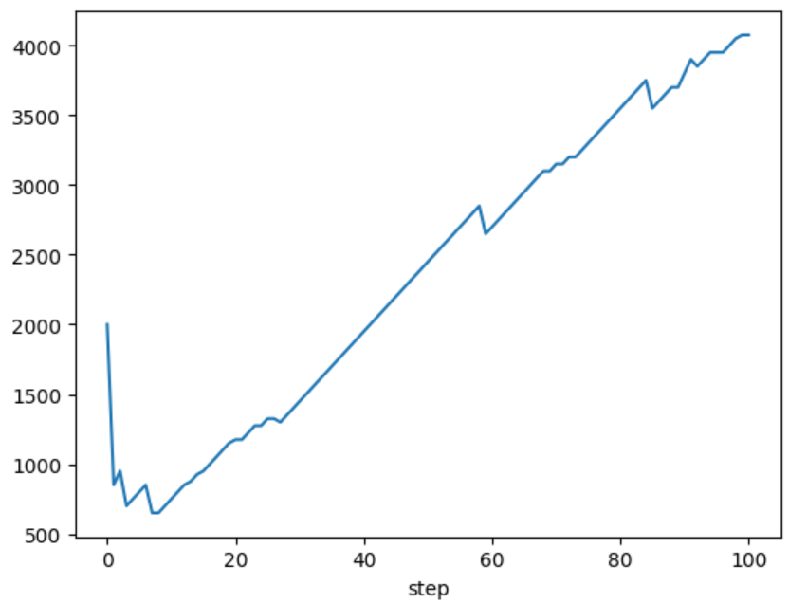
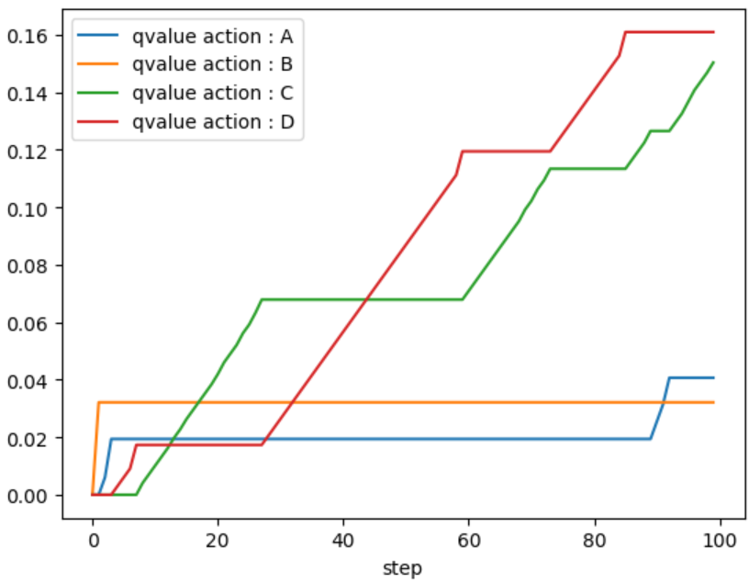
4. Execution result and Analysis
Estimated parameter of team members applied Simulation
Cumulative Rewards
Q value for action
박시윤
Q-learning
VS Q-learning

Slide 25
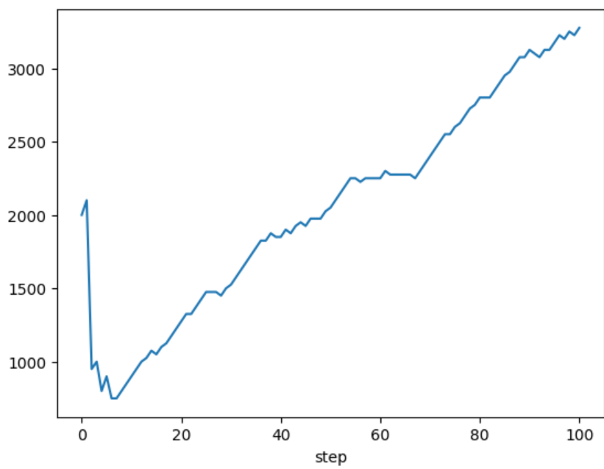
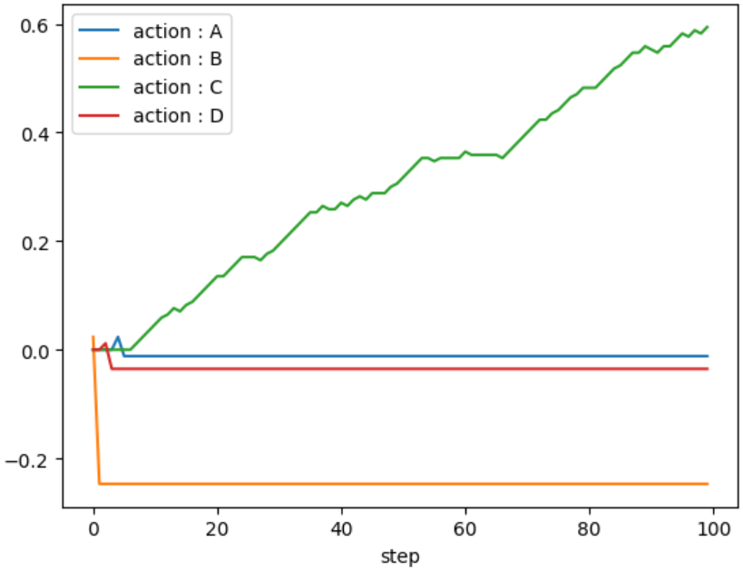
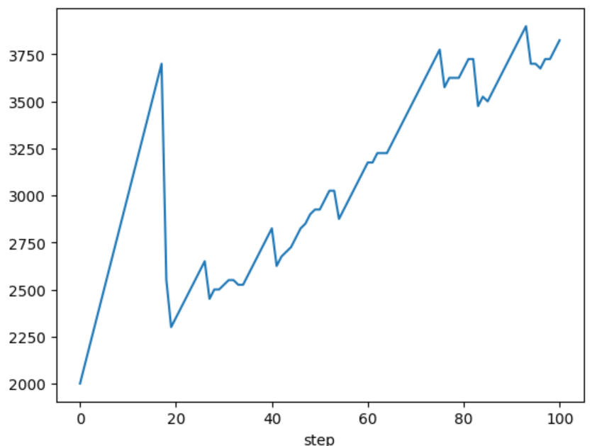
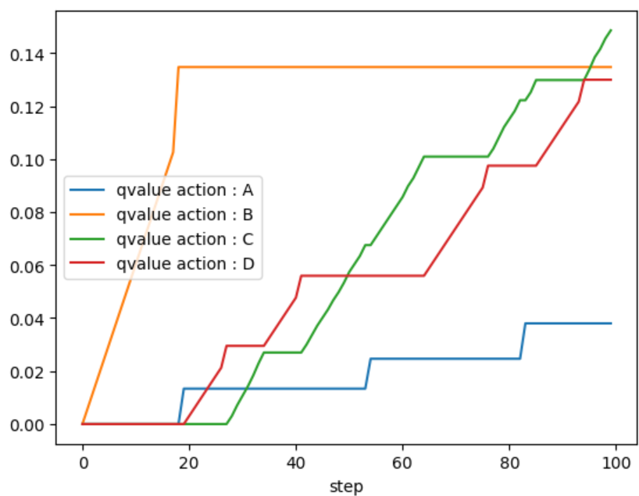
4. Execution result and Analysis
Estimated parameter of team members applied Simulation
Cumulative Rewards
Q value for action
이상아
Q-learning
VS Q-learning

Slide 26
5. Conclusion
1) Project Goal Achieved
By estimating learning parameters (α, β, w) from 602 participants using Maximum Likelihood Estimation (MLE), and applying clustering and simulations based on Q-learning and Valence-Specific Q-learning models,
→ we successfully explained human decision-making behavior in the Iowa Gambling Task (IGT).
2) Key Findings from Models
- Q-learning Clustering:
• Cluster 0: High α, Low β → Rapid convergence with minimal exploration.
• Cluster 1: Low α, High β → Slower learning with more trial-and-error.
- VSQ-learning Insights:
• Cluster 0: More loss-sensitive (Low w), formed stable strategies avoiding penalties.
• Cluster 1: More gain-sensitive (High w), ignored negative feedback and repeated poor choices.
3) Team Simulation & Implications
- Both Q-learning and VSQ-learning successfully modeled “individual” team members' decision patterns.
- Future work: Incorporate emotional factors, temporal discounting, and context for more refined modeling.

Slide 27
6. References and Resources
References
1. Bechara et al. (2013).
Insensitivity to future consequences following damage to human prefrontal cortex.
2. Busemeyer, J. R., & Stout, J. C. (2002).
A contribution of cognitive decision models to clinical assessment: Decomposing performance on the Bechara gambling task.
3. Haines, N., Vassileva, J., & Ahn, W.-Y. (2018).
The outcome‐representation learning model: A novel reinforcement learning model of the Iowa Gambling Task.
4. Naidoo, L. (2019).
Knowledge, attitudes and perceptions of Genomic Medicine among medical students, private medical practitioners and the general public in eThekwini, KwaZulu-Natal.
5. Kjome, K. L. et al.(2010)
Relationship between impulsivity and decision making in cocaine dependence.
6. Steingroever, et al.
Do intuitive and deliberate decision makers perform differently on the Iowa Gambling Task?
Resources
1. Datasets : https://osf.io/8t7rm/
2. Iowa Explanation & Game Simulation : https://www.psytoolkit.org/experiment-library/igt.html

Slide 28
Thank you for listening,
Q&A
202011003 강승수
202211080 박시윤
202311132 이상아

